Slide 1
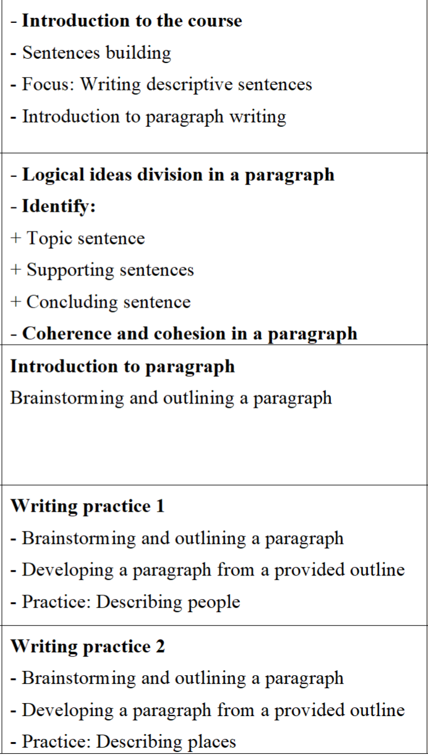
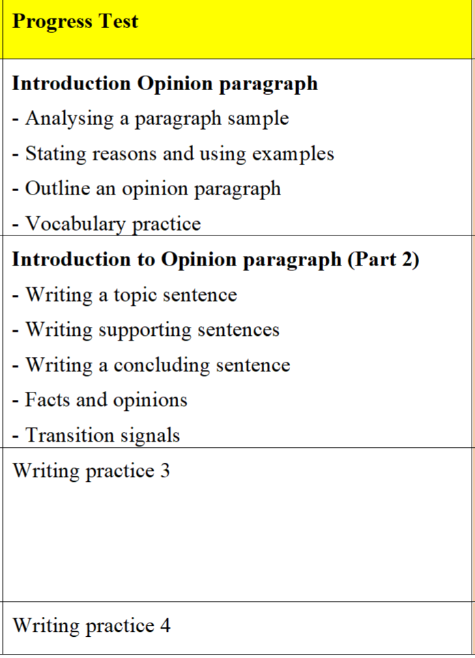
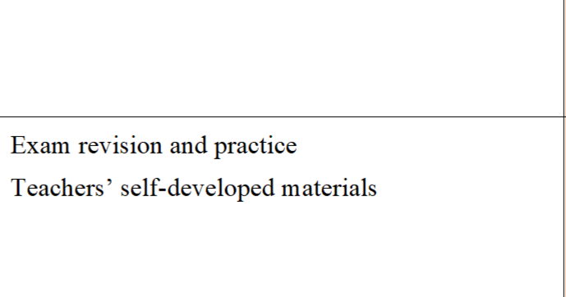
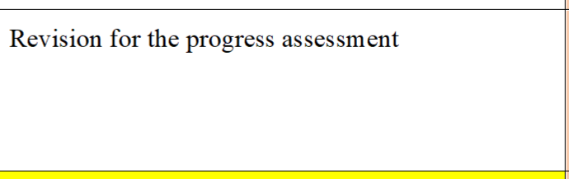
WRITING – TERM 1
SYLLABUS
Week 1
Week 7
Week 8
Week 2
Week 9
Week 3
Week 10
Week 4
Week 11
Week 5
Week 12
Week 6

Slide 2
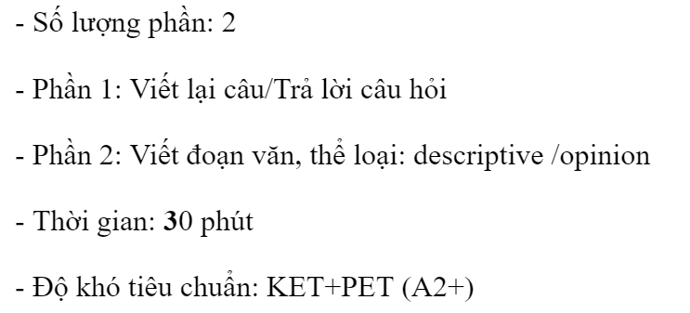
MARK ALLOCATION
- Participation (in-class participation + MY ELT completion): 10%
- Progress test: 30% (Describing people/places)
- Final test: 60%

Slide 3
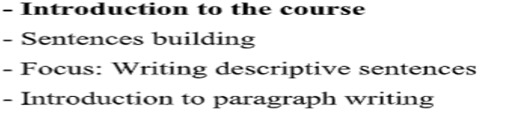
LESSON 1

Slide 4
SENTENCE BUILDING
Exploring the Diversity of English Sentences
Can you list different types of sentences?
Simple sentences
Compound sentences
Complex sentences
Compound – complex sentences
Declarative sentences
Interrogative sentences
Imperative sentences

Slide 5
Simple Sentences
1
Subject-Verb
2
Subject-Verb-Object
The cat meows.
The boy throws the ball.
3
Subject-Verb-Adjective
The flower is beautiful.
Simple sentences contain one independent clause and convey a complete thought.

Slide 6
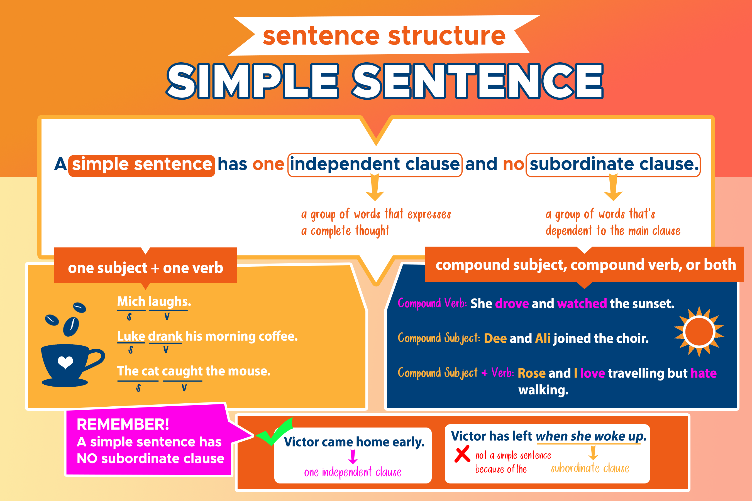

Slide 7
Compound Sentences
Two Independent Clauses
Coordinating Conjunctions
Balanced Structure
The sun is shining, and the birds are singing.
Common conjunctions are "and," "but," "or," and "yet."
Compound sentences have two equal parts that are grammatically independent.
Compound sentences link two independent clauses together.

Slide 8
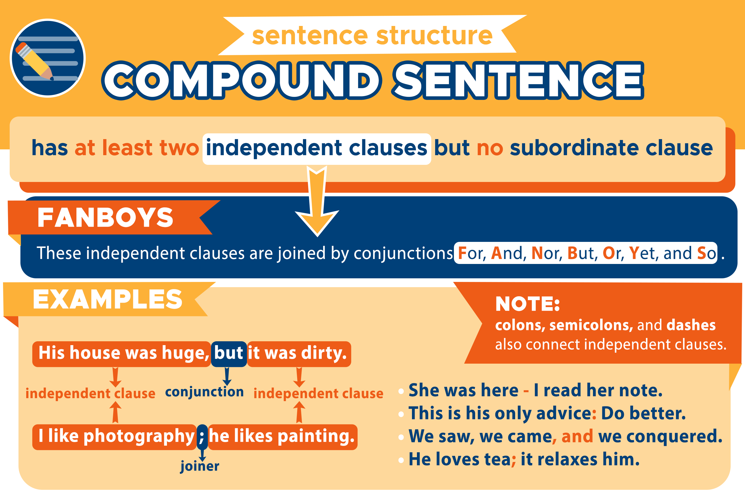

Slide 9
Complex Sentences
Subordinating Conjunctions
Independent Clause
Words like "because," "when," and "if" introduce dependent clauses.
The sentence has one main clause.
1
2
3
Dependent Clause
One or more subordinate clauses provide additional information.
Complex sentences combine an independent clause with one or more dependent clauses.

Slide 10
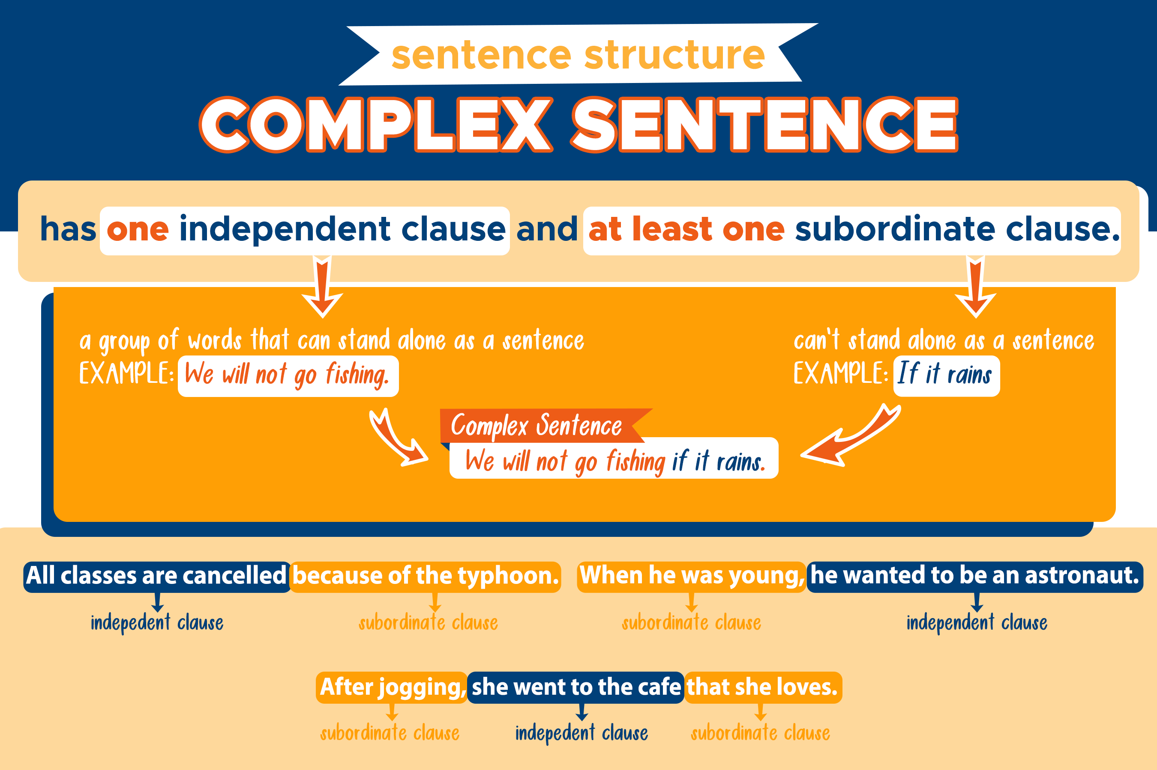

Slide 11



Compound-Complex Sentences
Two Independent Clauses
The sentence has two main clauses.
Dependent Clause(s)
One or more subordinate clauses provide additional information.
Coordinating and Subordinating Conjunctions
The clauses are linked with both coordinating and subordinating conjunctions.
Compound-complex sentences combine the elements of compound and complex sentences.

Slide 12
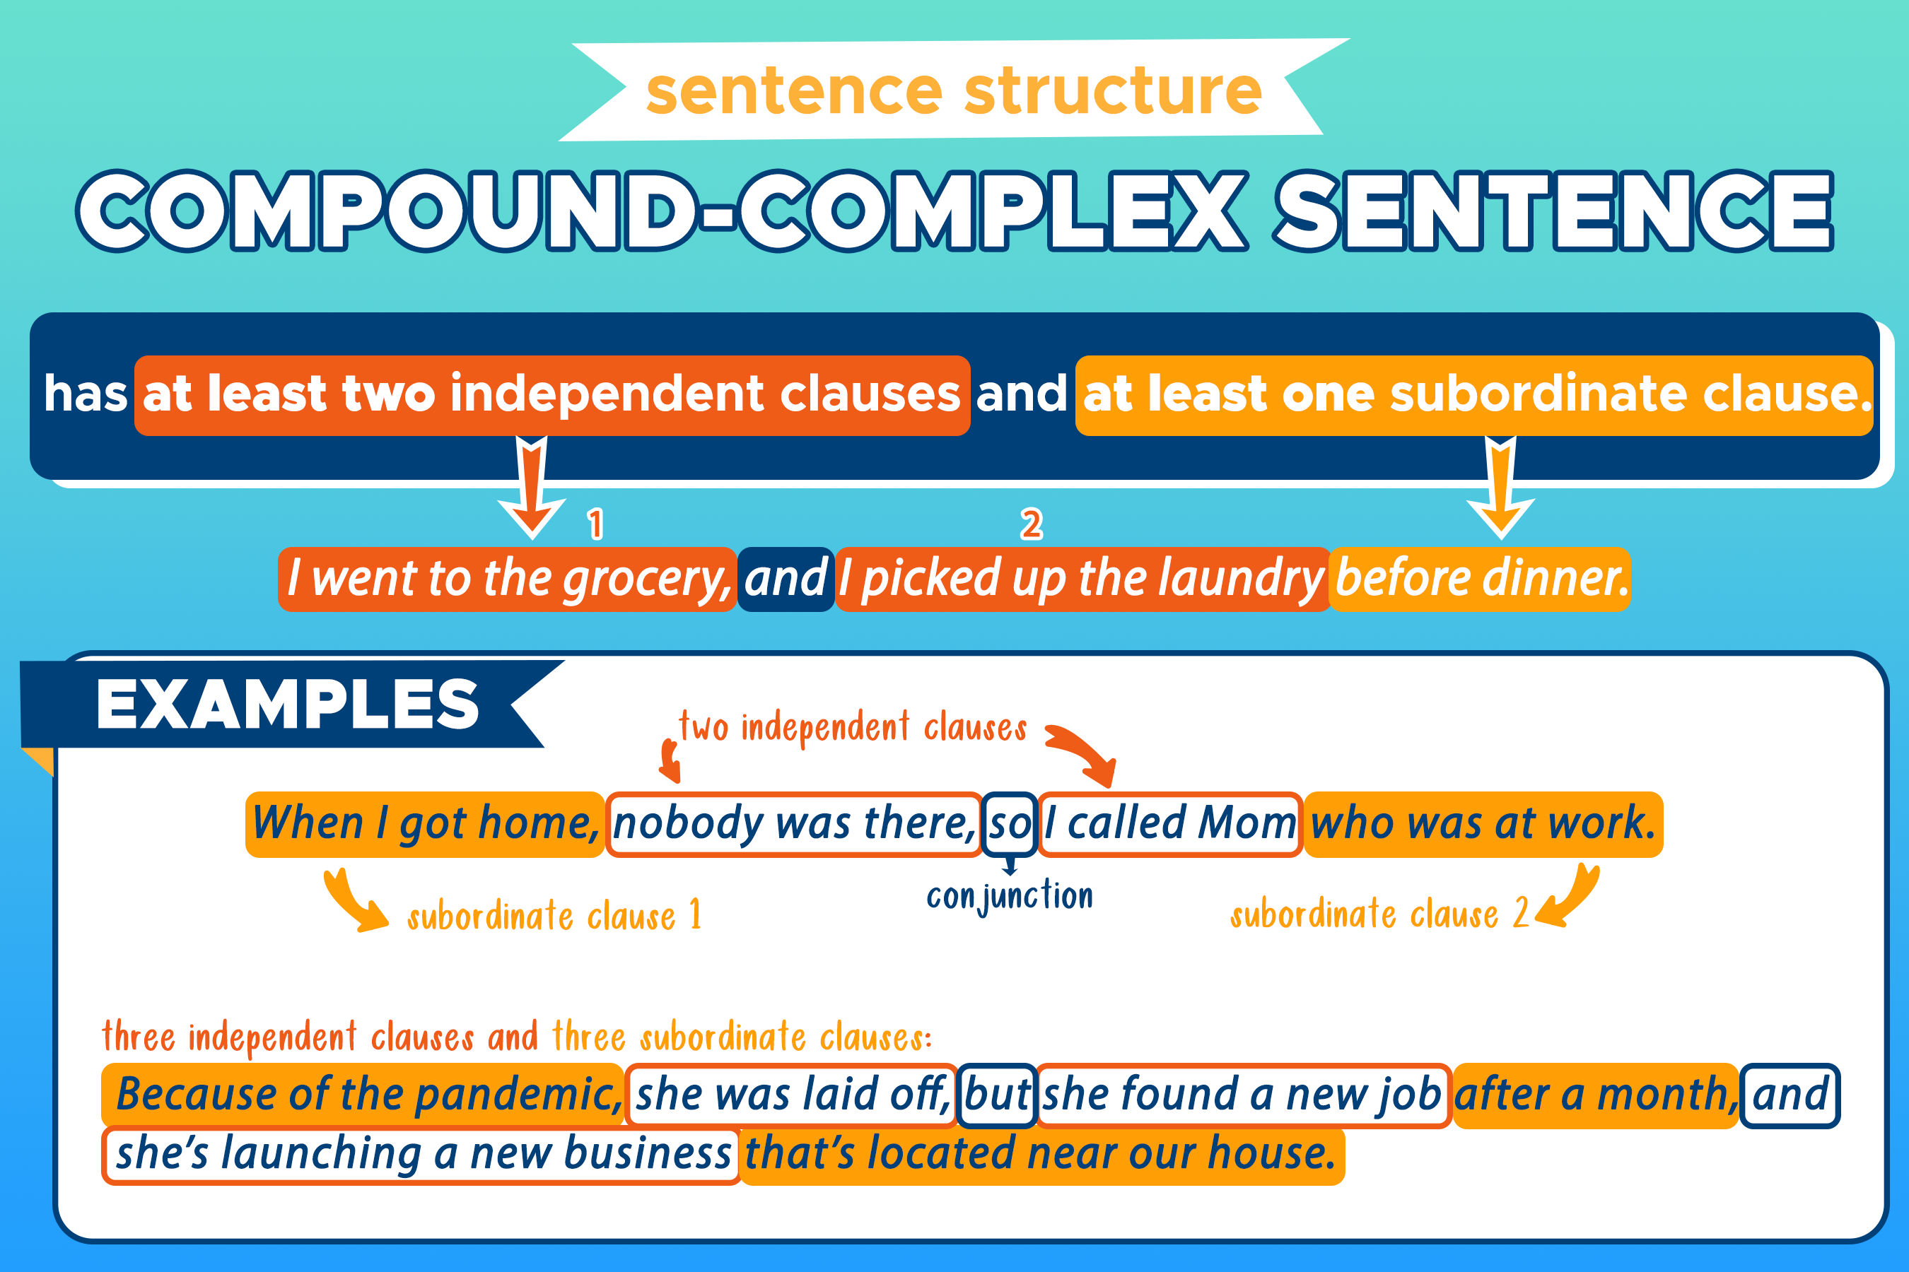

Slide 13
Declarative Sentences
(Câu trần thuật)
Making a Statement
Ending with a Period
Declarative sentences express a fact or an opinion.
Declarative sentences end with a period (.) to indicate a complete thought.
Most Common Sentence Type
Declarative sentences are the most commonly used type of sentence in English.
Declarative sentences are the most basic and straightforward type of sentence.

Slide 14
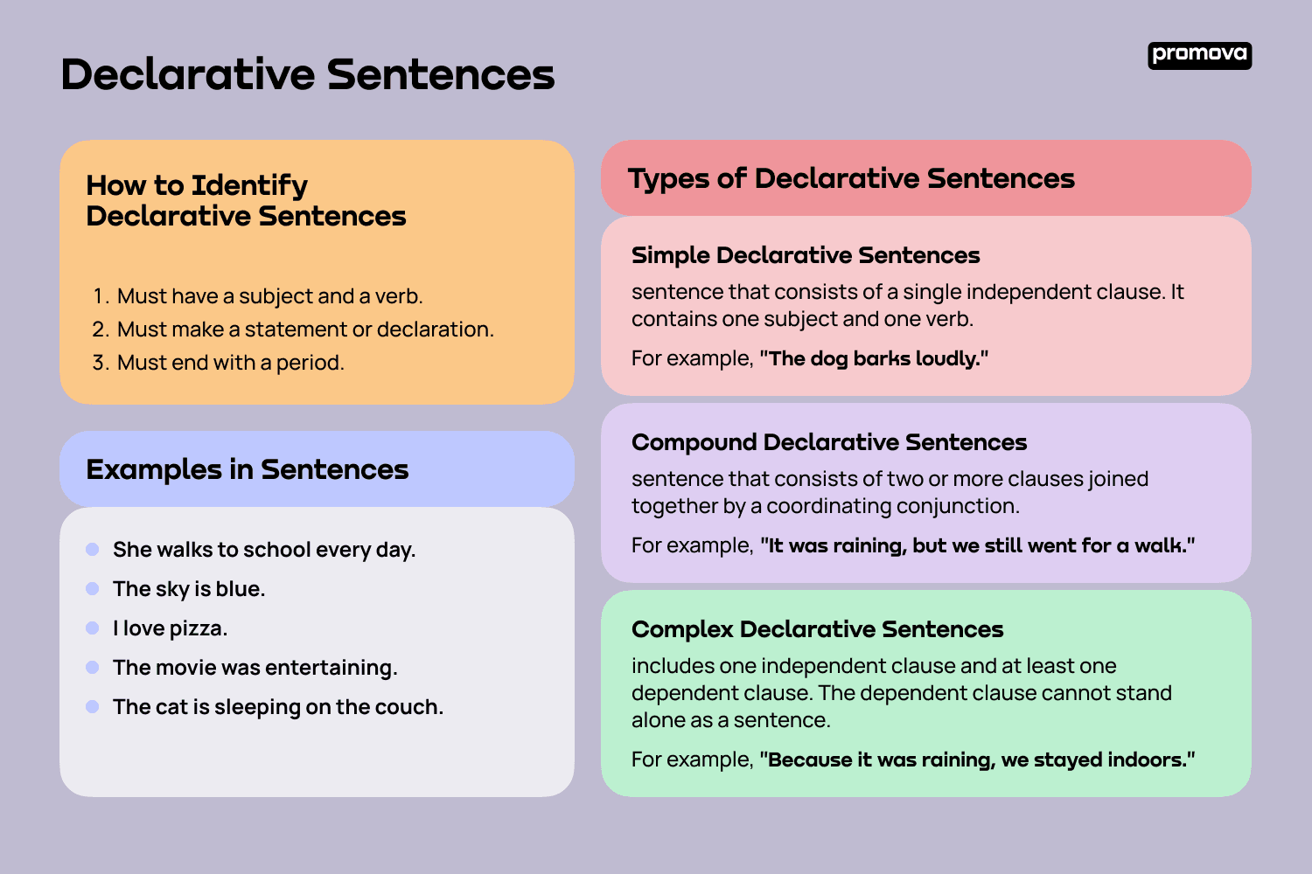

Slide 15



Interrogative Sentences
(Câu nghi vấn)
Asking Questions
Question Words
Ending with a Question Mark
Interrogative sentences are used to ask questions.
They often begin with words like "who," "what," "when," "where," "why," or "how."
Interrogative sentences end with a question mark (?) to indicate a question.
Interrogative sentences are used to ask questions and seek information.
Example: Whom did the teacher give the books to?

Slide 16
Imperative Sentences
(Câu mệnh lệnh)
Direct Command
Imperative sentences give a direct command or instruction.
Omitted Subject
The subject "you" is usually omitted in imperative sentences.
Ending with a Period
Imperative sentences end with a period (.) to indicate a complete command.
Imperative sentences are used to give orders, make requests, or provide instructions.

Slide 17
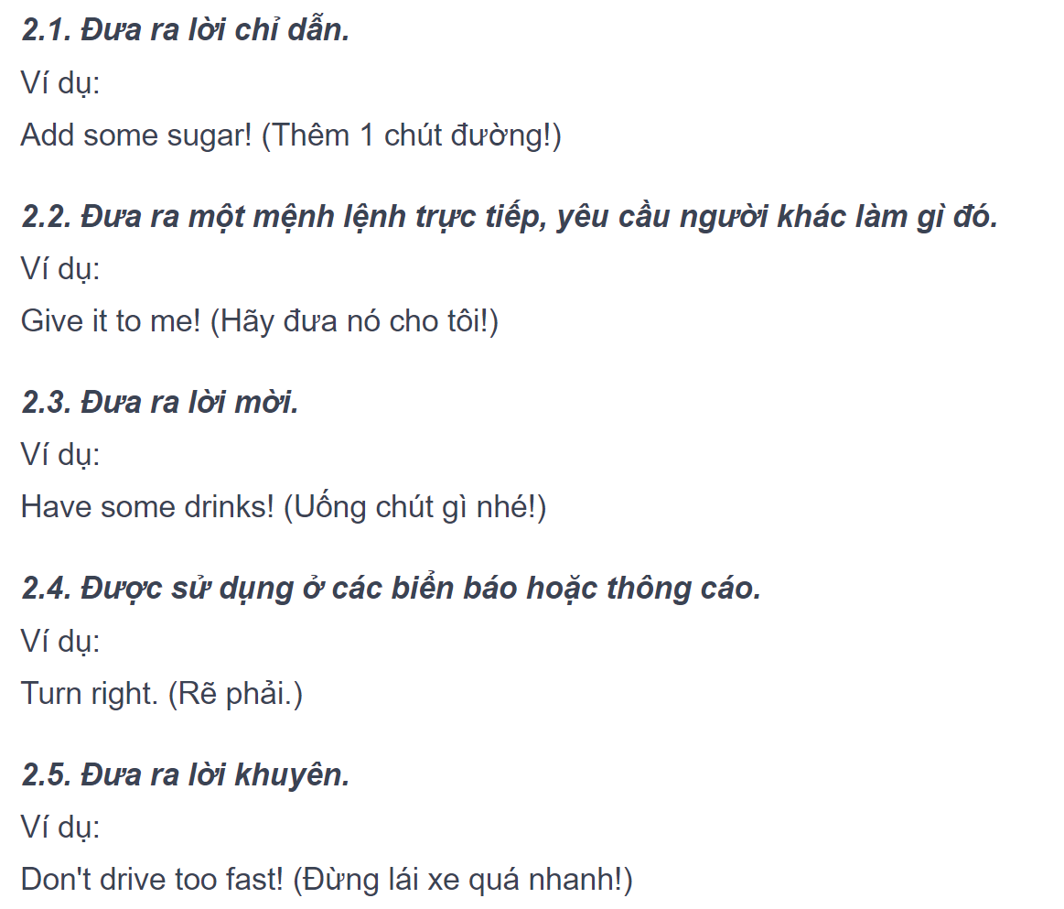
Imperative Sentences

Slide 18
Practices
Complete exercises from the course book (practice 4, 6, 8,10, 11)
Practice 9 – random check with teacher
Homework: write 10 sentences (simple, compound, complex and
compound-complex) about your family.

Slide 19
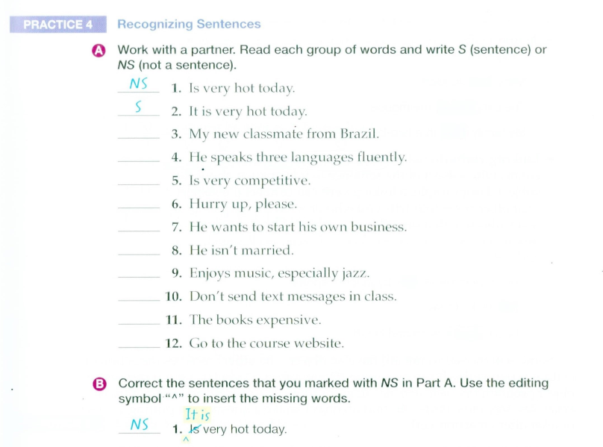

Slide 20
NS
S
NS
S
S
S
NS
S
NS
S

Slide 21
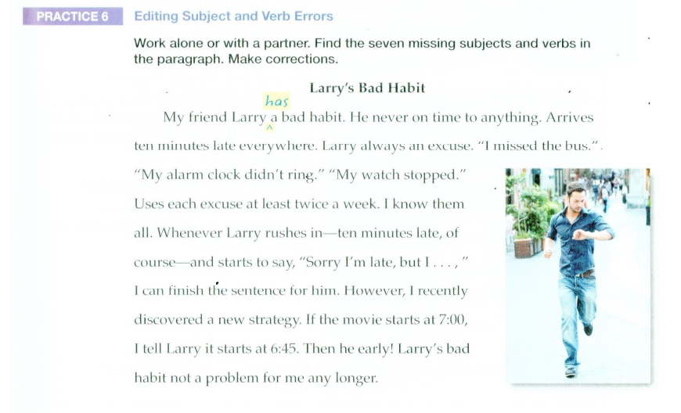

Slide 22
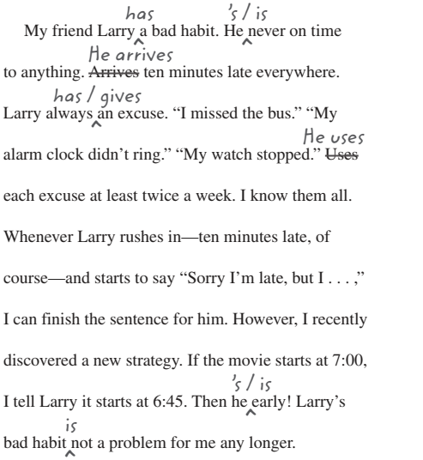
Practice 6

Slide 23
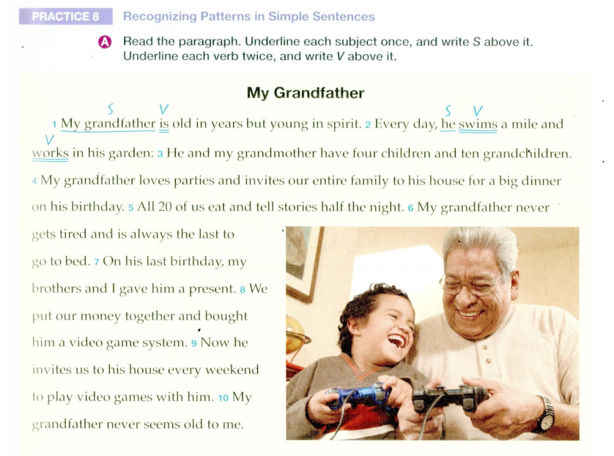

Slide 24
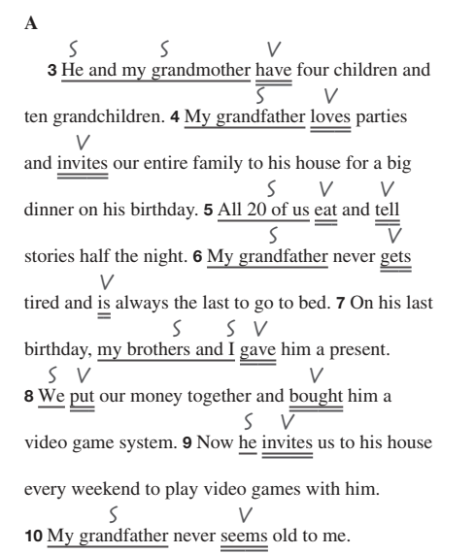
Practice 8

Slide 25
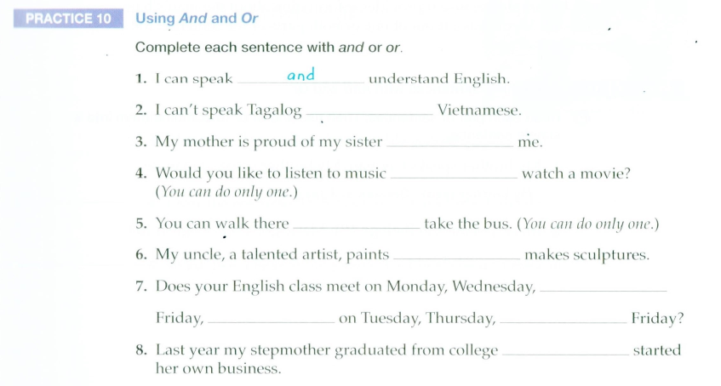
or
and
or
or
and
and
or
and
and

Slide 26
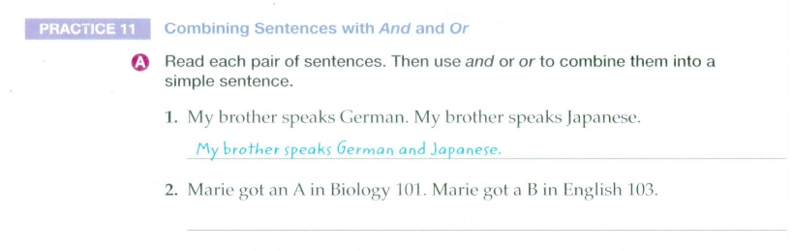
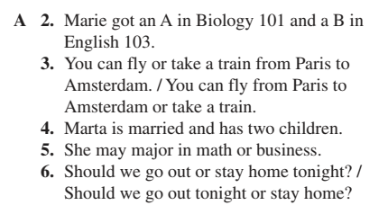
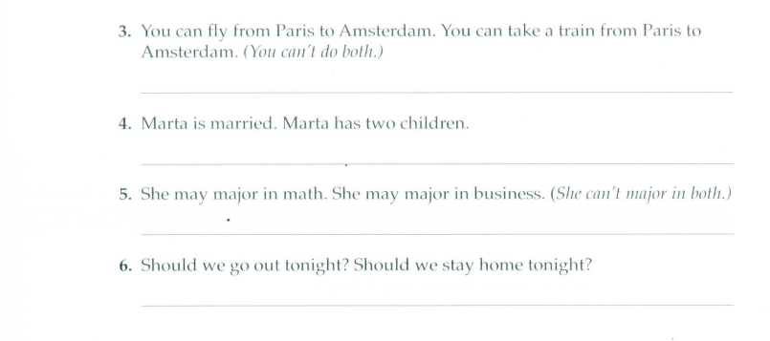

Slide 27
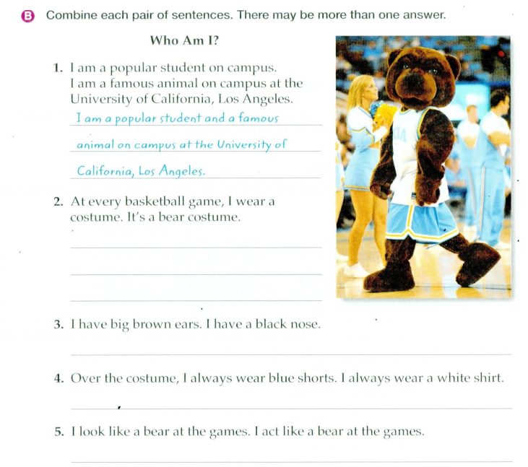
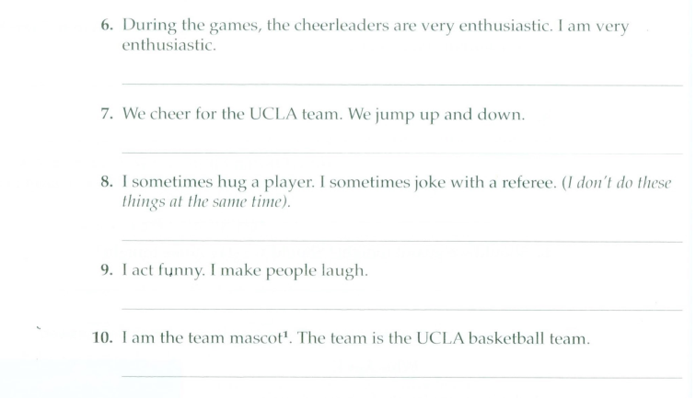
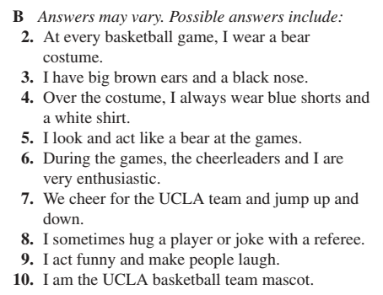

Slide 28
